Slide 1
应用统计与深度学习实验课
高婷
2021年10月9日

Slide 2
Recap
Data manipulation tools
Deep Learning Basics:
Linear Regression, Multi-class classification, Customize MLP
Model training pipeline and tensorboard practice.
Modern Models:
CNN/ ResNet
RNN, LSTM
VAE, GAN

Slide 3
Today
Recommendation System
Reinforcement Learning

Slide 4
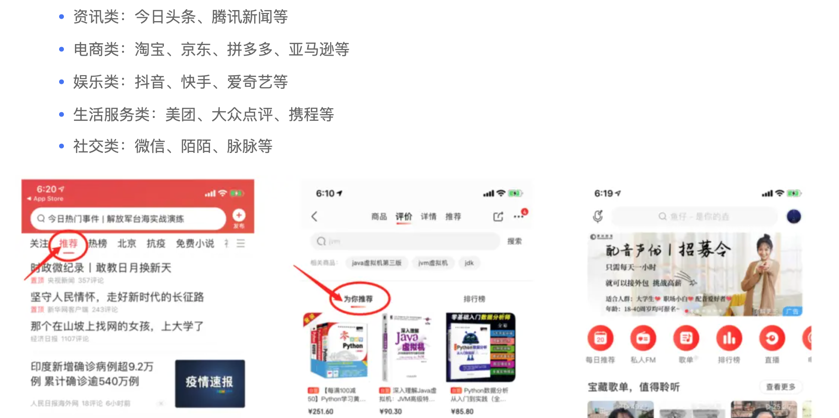
What is a recommendation system?
Recommendation systems are the core of online services such as Amazon, Netflix, Youtube, Spotify.... Infomation filtering system that seeks to predict the "rating" or "preference" a user would give to an item.

Slide 5
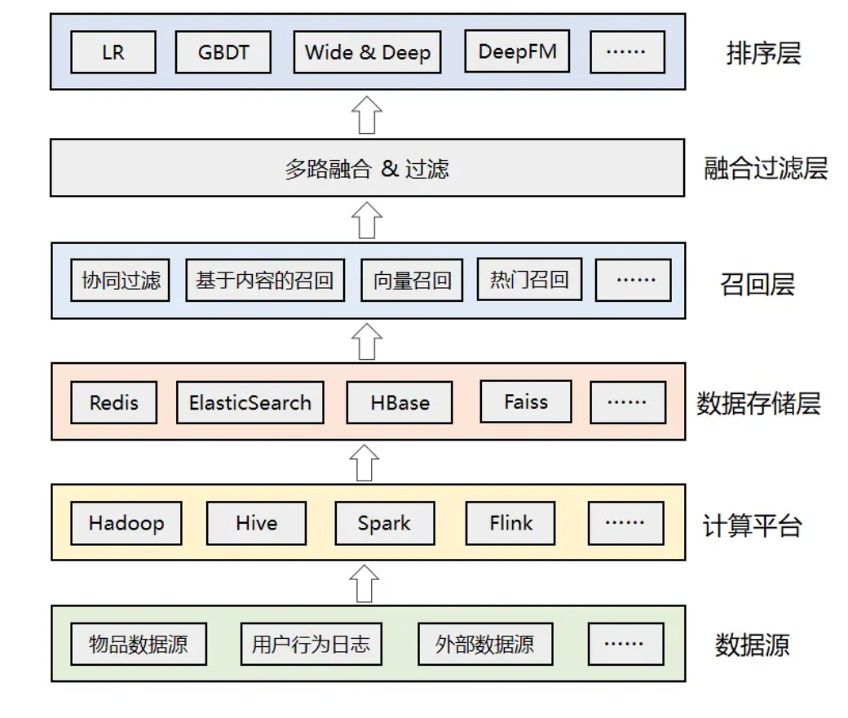
General Architecture for Recommendation System
特征工程？
算法复杂度如何降低？
实时性如何满足？
新加入的物品或者用户该如何推荐？
算法效果和工程性能的权衡。
推荐系统的稳定性和效果追踪。
完善的数据监控和应用监控体系，同时有 ABTest 平台进行灰度实验，进行效果对比。

Slide 6
Feedback：explicit or implicit
Implicit feedback: often readily available since it is mainly concerned with modeling implicit behavior such as user clicks, can have diverse forms of implicit feedback including purchase history, browsing history, watches and even mouse movements. Inheretly noisy.
Explicit feedback: It is apparent that gathering explicit feedback requires users to indicate their interests proactively. Nonetheless, explicit feedback is not always readily available as many users may be reluctant to rate products.

Slide 7
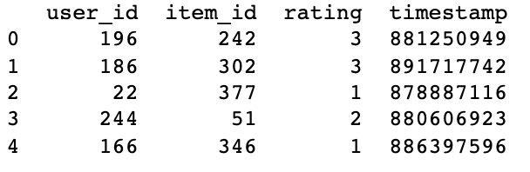
Data exploration
Ex: MovieLen Data
Notes:
simple MF example https://jovian.ai/aakanksha-ns/anime-ratings-matrix-factorization
Based on their popularity
Based on the user’s previous interaction
Based on interactions of similar users
based on a mixture of the above.

Slide 8
Recommendation System
Matrix Factorization
AutoRec
Bayecian ranking with autoencoder
Nueral Collaborative Filtering
Sequential
Factorization Machines
Deep Factorization Machines
https://github.com/rixwew/pytorch-fm

Slide 9
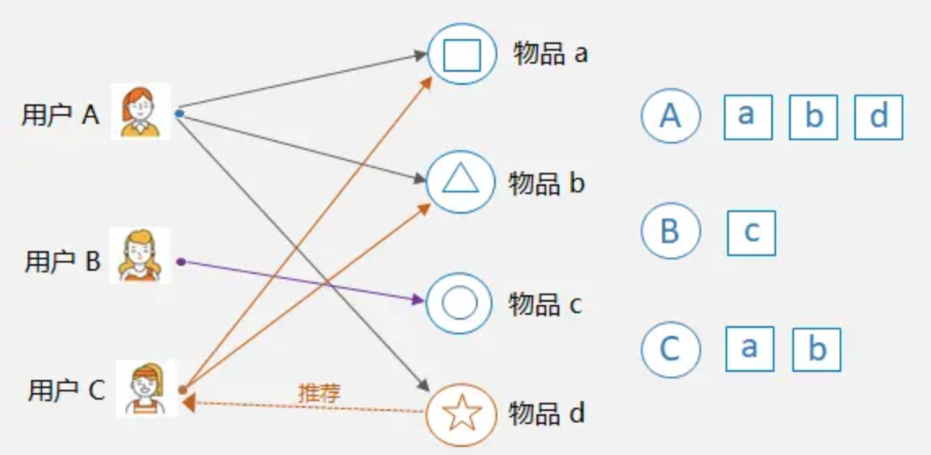
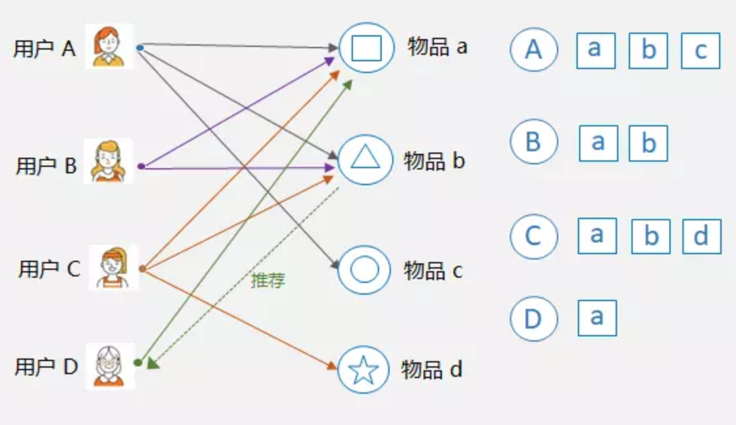
Problem formulation
User-based CF：look at similar users and recommend items that they like
Item-based CF: find similar items based on ratings given by other users
Model-based CF：Model interaction matrix between items and users. Each user and item can be mapped into an embedding space based on their features --> Matrix factorization

Slide 10
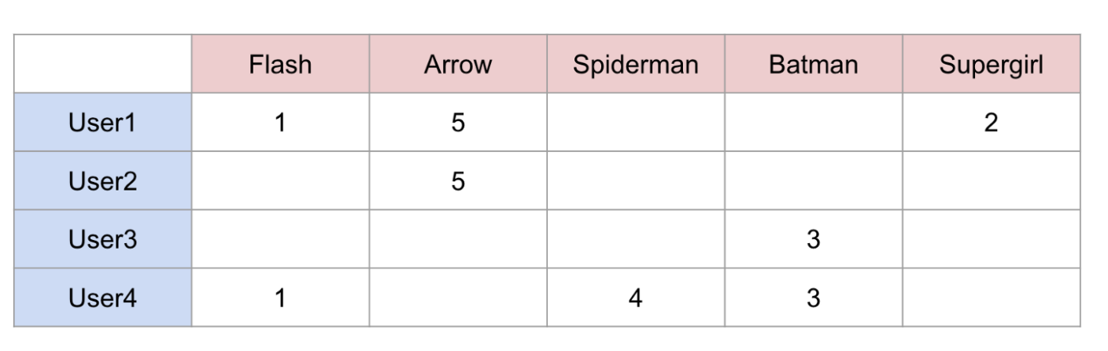
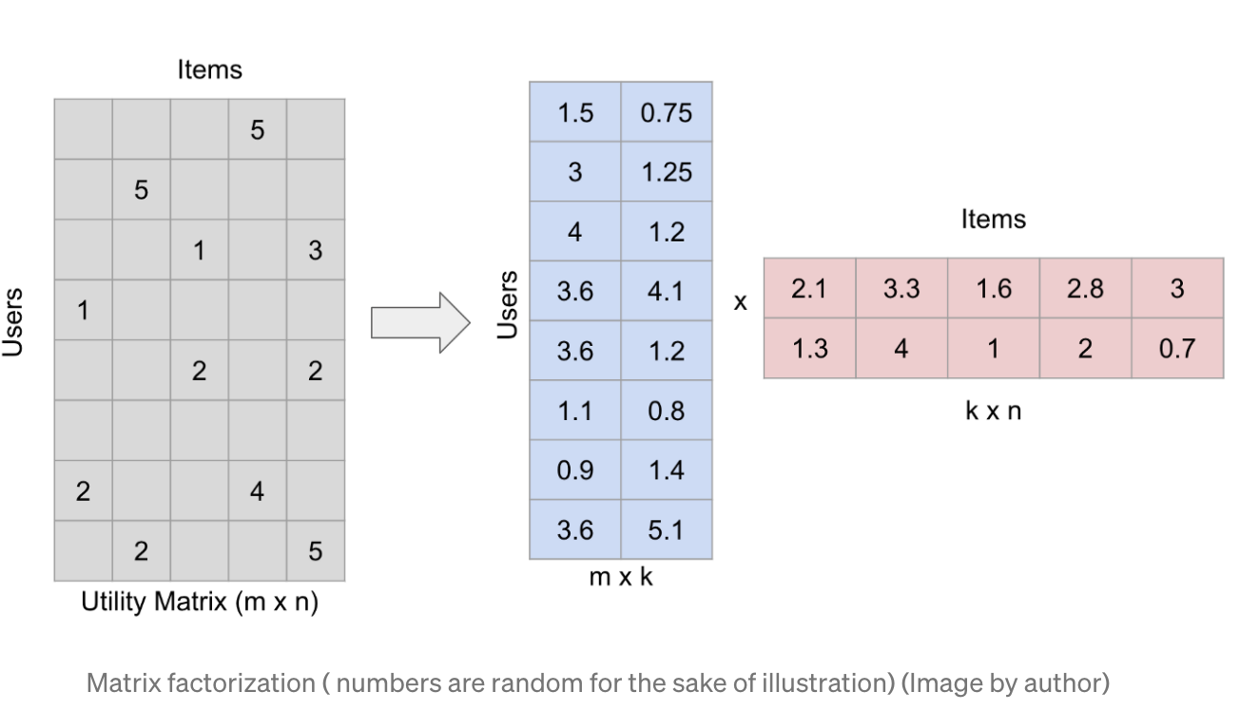
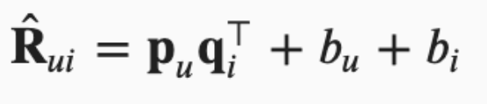
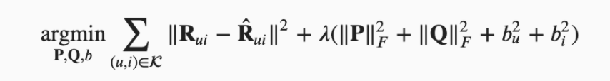
1. Matrix Factorization
Notes:
https://towardsdatascience.com/recommender-systems-matrix-factorization-using-pytorch-bd52f46aa199

Slide 11
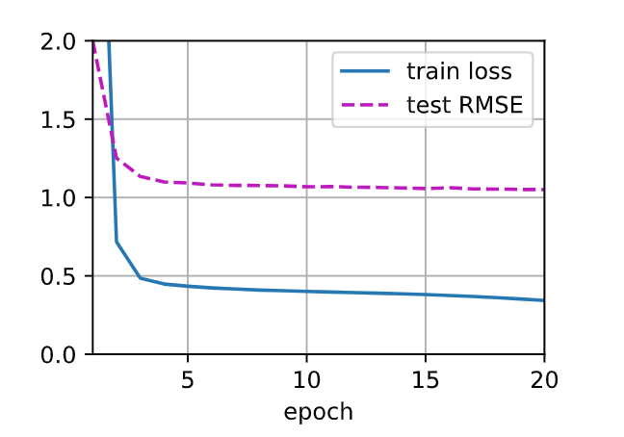
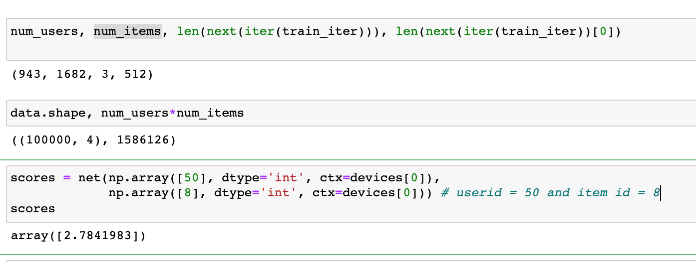
1. Matrix Factorization

Slide 12
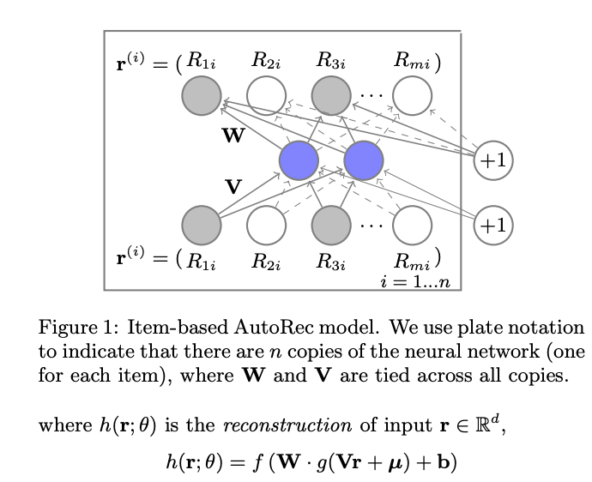
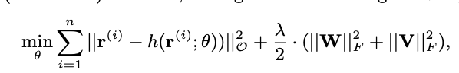
2. Autorec: Autoencoder CF
user: 1...m
iterm: 1...n
Note: backpropagation only on observable data !!

Slide 13
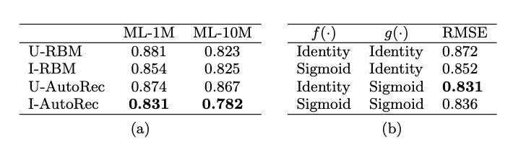
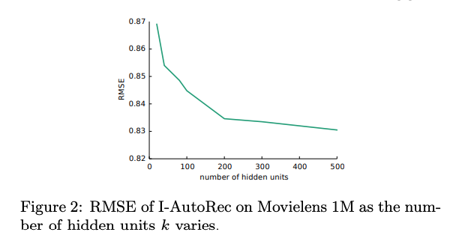
How to explain impact of depth and # of hidden layers on performance?
Other generative modeling framework?
More ideas?
More Autoencoder-based systems include: DeepRec, Collaborative Denoising Auto-Encoders, Multinomial Variational Auto-encoder, Embarrassingly Shallow Autoencoders for Sparse Data

Slide 14
3. Bayesian Personalized ranking(BPR) [Rendle et al., 2009]
So far,
Only explicit feedback was considered
Models were trained and tested on observed ratings. Non-observed user-item pairs are a mixture of real negative feedback and missing values.
Pointwise approaches , that is a single interaction at a time and train to predict individual preference.
New:
- Implicit feedback
- Pairwise approaches: Bayesian loss, Hinge loss

Slide 15
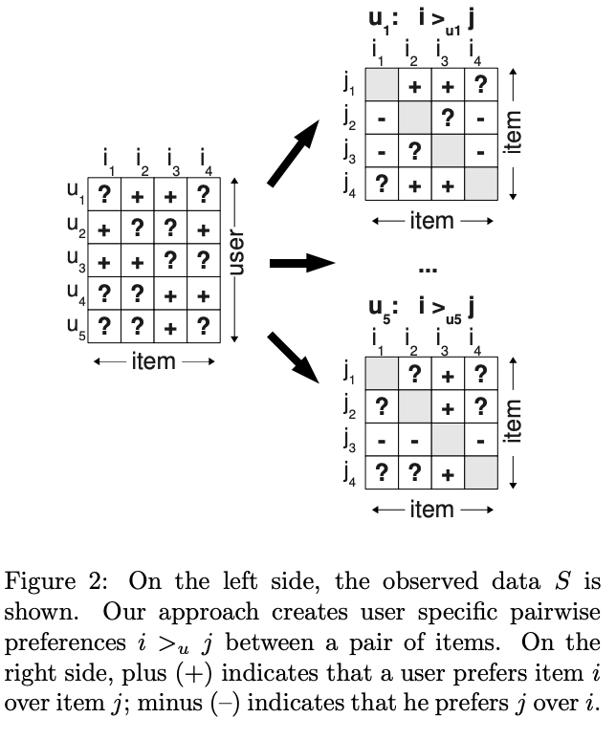
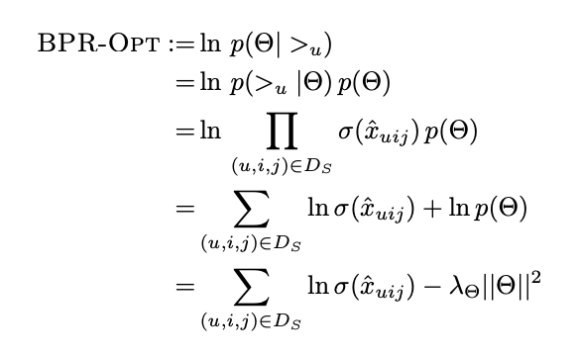
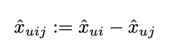
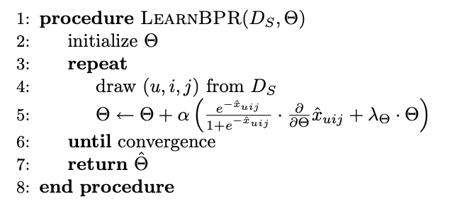

Slide 16
4. Neural Collaborative Filtering 2017
Address personalized ranking task using implicit feeback!
Leverage flexability and non-linearity of neural networks to place dot products of matrix factorization, aiming to enhancing modlel performance.
GMF(generalized matrix factorization) and MLP models interactions from two pathways
generate a ranked recommendation list to each user based on implicit feedback
Notes:
The GMF is a neural network approach of matrix factorization where the input is an element-wise product of the user and item embeddings and the output is a prediction score that maps the interaction between the user and the item.
The MLP model serves as an extra layer on modeling the user-item interaction. It concatenates the user and item embeddings and through the addition of more non-linear layers, it models the collaborative filtering effect.
To fuse the two models, no embeddings were shared in fear of limiting the model’s capacity. Instead, NeuMF concatenates the second last layers of two subnetworks to create a final interaction score. This way, we can generate a ranked recommendation list for each user based on the implicit feedback.

Slide 17
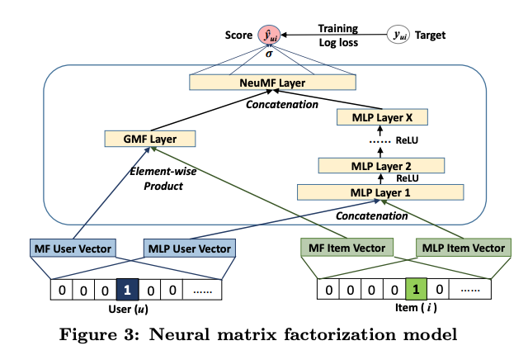
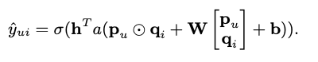
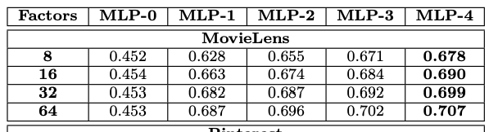

Slide 18
Does deeper network help more on the performance?
How to find optimal factorial dimension?
More ideas?

Slide 19
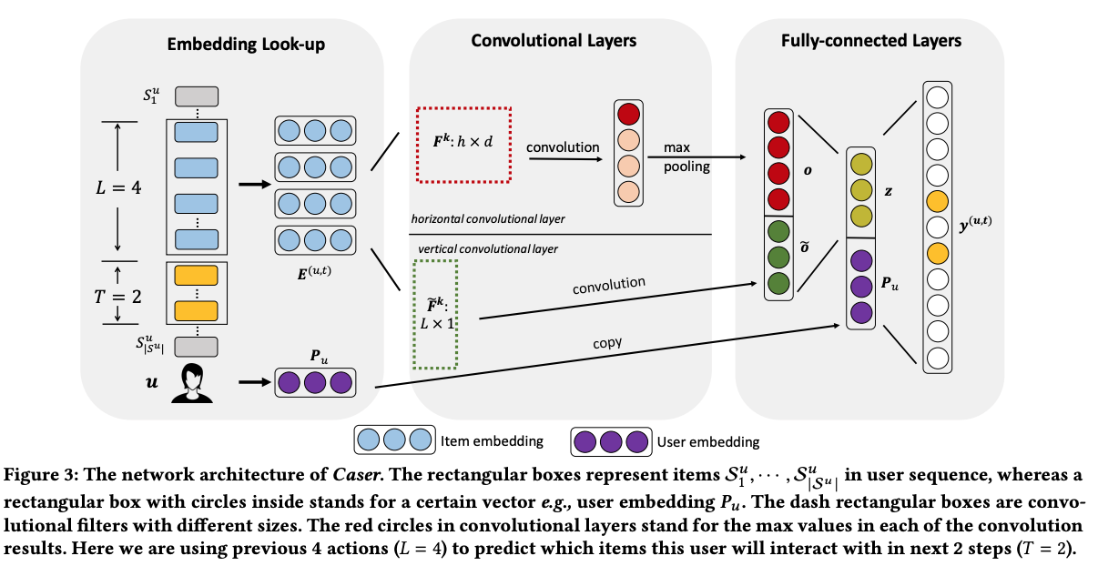
5. Sequential aware

Slide 20
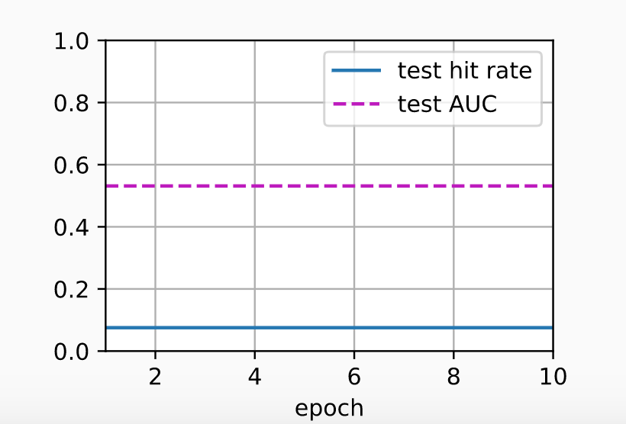
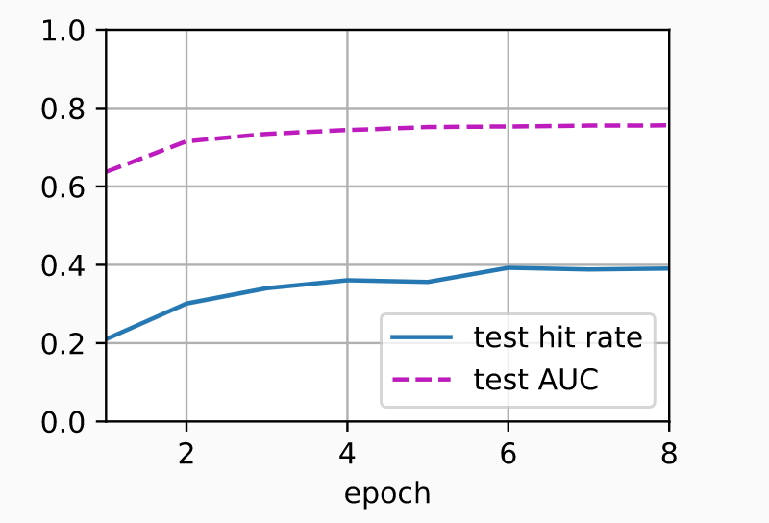
Neural collaborative filtering vs. Sequential aware collaborative filtering

Slide 21
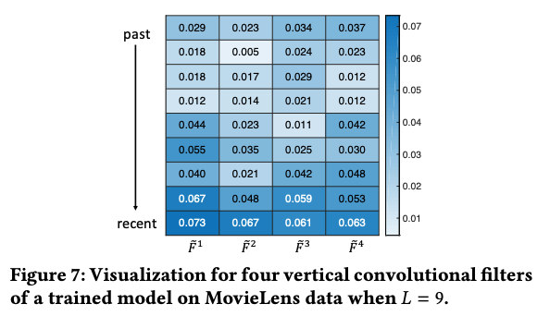
Sequential aware

Slide 22
More:
Sequence aware systems can be divided into different categories:
Context-aware or not
Short-term or Long-term
Session-based or not
Sequence-aware systems can model the users behavior very effectively and in many cases outperform CF-based systems. A hybrid system consisting of both approaches usually works even better.
SOTA sequence-based models include: GRU4Rec, BERT4Rec, SASRec

Slide 23
6. Factorization Machines [Rendle, 2010],
The strengths of factorization machines over the linear regression and matrix factorization are:
(1) it can model 𝜒 -way variable interactions, where 𝜒 is the number of polynomial order and is usually set to two.
(2) A fast optimization algorithm associated with factorization machines can reduce the polynomial computation time to linear complexity, making it extremely efficient especially for high dimensional sparse inputs.

Slide 24
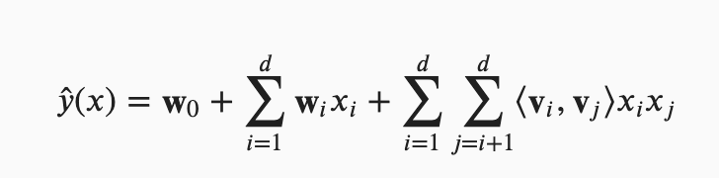
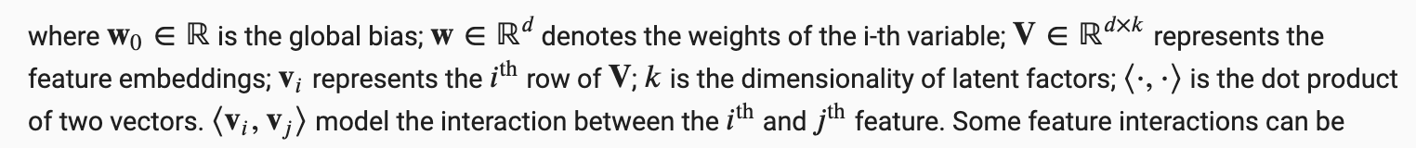
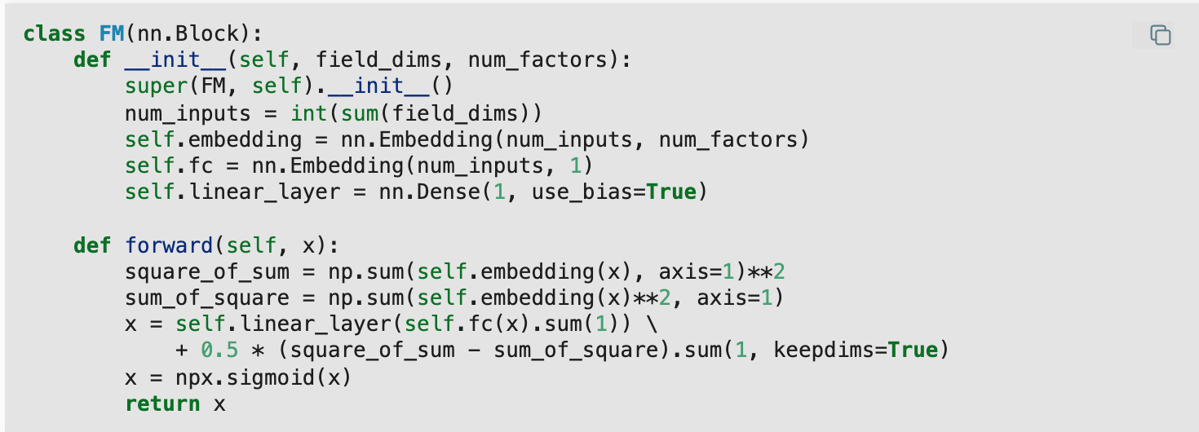

Slide 25
7. Deep Factorization Machine [Guo et al., 2017]
Modeling higher degrees of feature combinations with factorization machines is possible theoretically but it is usually not adopted due to numerical instability and high computational complexity.
One effective solution is using deep neural networks. Adding nonlinear transformation layers to factorization machines gives it the capability to model both low-order feature combinations and high-order feature combinations.

Slide 26
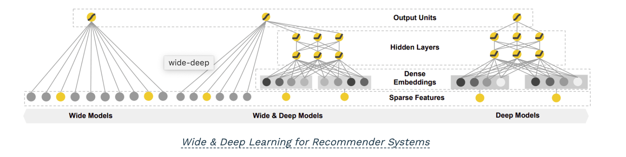
note: Wide and Deep
Memorization and generalization:
The goal is to memorize specific useful feature combinations. On the other hand, deep models are learning items and user embeddings, which makes them able to generalize in unseen pairs without manual feature engineering.

Slide 27
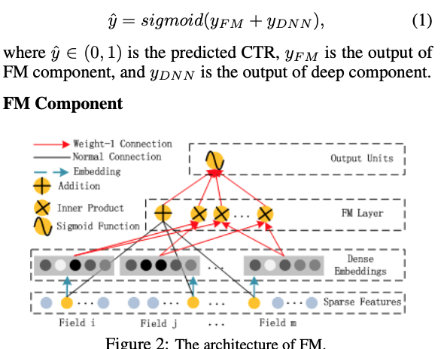
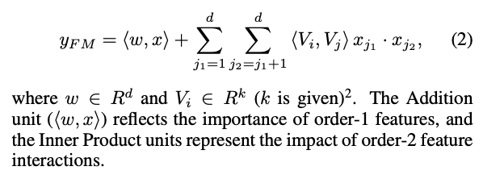

Slide 28
8. Deep and Cross Network (DCN)
Deep and Cross Network (DCN) is an architecture proposed by Google and is designed to learn explicit cross-features in an effective manner. As with many previous models, we have two submodules: The cross-network and the deep network. We can either stack the two networks on top of each other or combine their final prediction. The figure below follows the first approach.
(A cross-feature is a combination of 2 or more features which provides additional interaction information beyond individual features. A combination of 2 individual features is a 2nd degree cross-feature.)

Slide 29
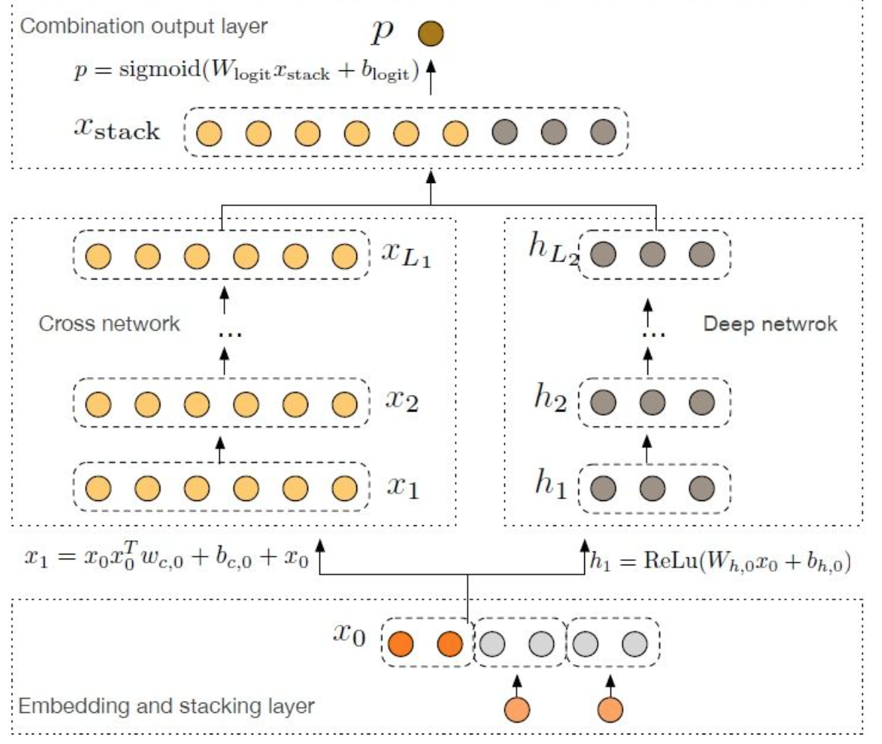
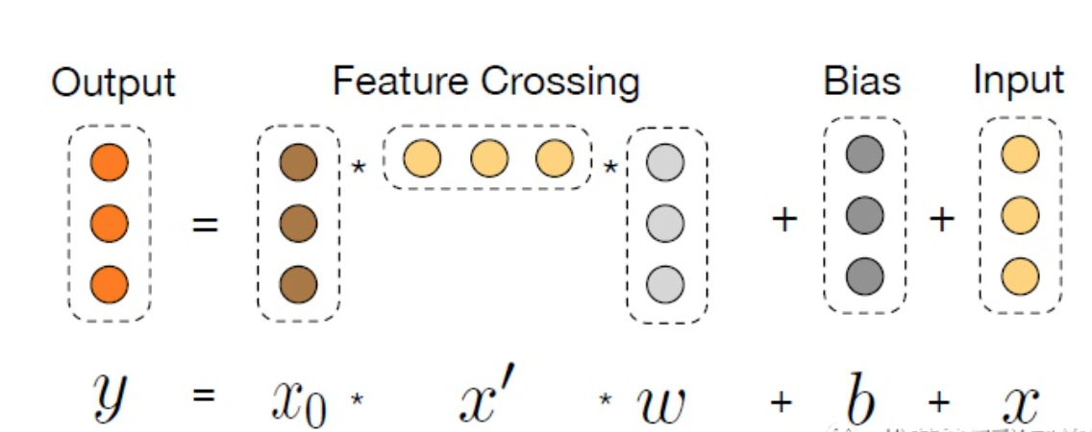

Slide 30
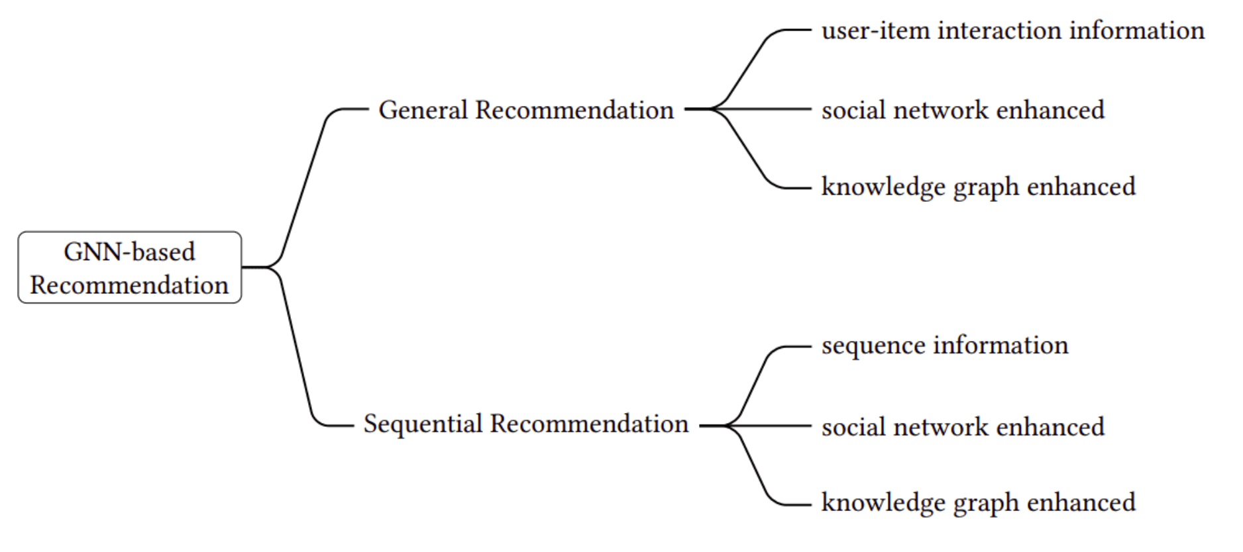
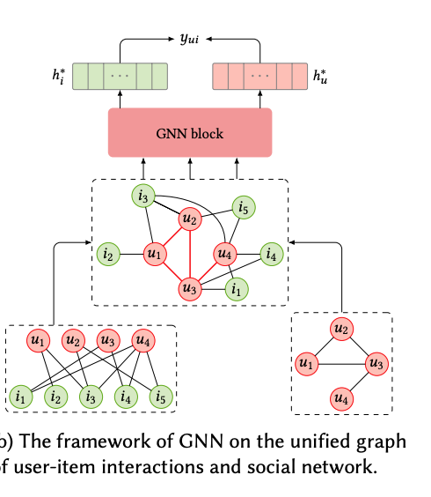
Many more: Graph Neural Networks in Recommender Systems: A Survey

Slide 31
Conclusion
Most strategies are based on a combination of low-level and high-level representation, which have been proven to work very well.
https://github.com/yoongi0428/RecSys_PyTorch
https://github.com/hyunjoonbok/Recommendation_System-PyTorch
https://github.com/facebookresearch/dlrm
Notes:
From 2009 where the infamous 1 million Netflix prize competition took place until today, recommenders have evolved tremendously.
Most strategies are based on a combination of low-level and high-level representation, which have been proven to work very well.
Sequence-based techniques, graph neural networks, and even reinforcement learning methods (which we didn’t mention) can be excellent alternatives in specific problems
TensorFlow Recommenders

Slide 32
Reinforcement Learning

